Slide 1

DEPARTMENT OF MASTER OF COMPUTER APPLICATIONS
PROJECT REVIEW
PROJECT TITLE : BLACK SPOT DETECTION USING MACHINE LEARNING(GPS)
GUIDE : Mr. K. RAMA KRISHNA
DEPARTEMENT : MCA
Name of the Student : NAKKINA LALITHA KAVYA
Regd No/Hall ticket no : 24NU1F0025

Slide 2
PROBLEM STATEMENT
Road accidents are increasing rapidly, and many of them repeatedly occur at specific locations called black spots. Existing accident analysis systems mainly depend on manual surveys and historical reports, which are time-consuming and not suitable for real-time usage. Drivers are usually unaware of these dangerous zones until an accident happens. Current navigation systems do not provide proactive warnings about accident-prone areas. There is no intelligent mechanism to predict or classify black spots using data-driven techniques. Hence, an automated and intelligent system is required to identify, predict, and alert users about black spots using Machine Learning and GPS technology.

Slide 3
PROBLEM OBJECTIVES
Objective–1:
To analyze historical accident data and identify black spots using machine learning algorithms.
Objective–2:
To classify road locations based on accident frequency and severity.
Objective–3:
To provide real-time alerts to users when they approach accident-prone zones.
Objective–4:
To visualize black spots on an interactive map for better understanding.
Objective–5:
To assist transport authorities in decision-making through analytical insights.

Slide 4
LITERATURE SURVEY
S.No | Author & Year | Title | Description | Links
1 | Abdel-Aty et al., 2011 | Accident analysis using ML | A machine learning method to study past road accident data. | https://doi.org/10.1016/j.aap.2011.01.001
2 | Chang & Wang, 2006 | Crash prediction models | Their method improved accident prediction accuracy compared to traditional techniques. | https://doi.org/10.1016/j.trc.2006.05.002
3 | Xie et al., 2014 | Road safety analysis | SVM (Support Vector Machine) technique to study road accident data. | https://doi.org/10.1016/j.ssci.2014.01.007
4 | Kumar & Toshniwal, 2016 | Accident severity prediction | The Random Forest technique to predict accident severity. | https://ieeexplore.ieee.org
5 | Kwon et al., 2015 | GIS-based accident analysis | Their approach helped in finding accident-prone areas by location (spatial analysis). | https://doi.org/10.1016/j.jtrangeo.2015.02.004
6 | Chen et al., 2019 | Traffic accident prediction | Deep Learning techniques to predict traffic accidents | https://doi.org/10.3390/s19092103
7 | Pande & Abdel-Aty, 2009 | Crash risk estimation | Their approach helped in real-time accident risk analysis and improved roads | https://doi.org/10.1016/j.aap.2009.01.006

Slide 5
PROPOSED SYSTEM
Proposed System (Step-by-Step)
Step-1: Collect historical road accident dataset
Step-2: Preprocess data (cleaning, normalization)
Step-3: Train machine learning model
Step-4: Classify locations as black spot or non-black spot
Step-5: Integrate GPS for real-time location tracking
Step-6: Display black spots on interactive map
Step-7: Generate alerts when user approaches a black spot

Slide 6
METHODOLOGY (Clear Explanation)
Data Collection: Accident data is collected from traffic records containing location, time, severity, and cause.
Data Preprocessing: Missing values are removed and features are normalized for better model performance.
Model Training: Machine learning algorithms such as Random Forest or SVM are trained using historical data.
Prediction: The trained model predicts whether a road segment is accident-prone.
GPS Integration: User’s real-time location is tracked using GPS.
Alert System: When the user is near a black spot, voice and visual alerts are generated.
Visualization: Black spots are highlighted on maps for easy understanding.

Slide 7
Tools & Technologies
Frontend: HTML, CSS, JavaScript, Google Maps API
Backend: Python, Flask, ML algorithms
Dataset: Historical accident data (CSV)
Database: MySQL / SQLite
Programming Language: Python
Machine Learning Algorithms: Random Forest, Supervised Learning Models
Libraries: NumPy, Pandas, Scikit-learn
Mapping & GPS: OpenStreetMap / Google Maps
Development Tools: Python IDE, Machine Learning Frameworks

Slide 8
WORK PLAN & TIMELINE
Module | Activity | Duration
1 | Requirement Analysis | 2 weeks
2 | Data Collection | 2 weeks
3 | Data Preprocessing | 1 week
4 | Model Training | 2 weeks
5 | GPS Integration | 2 weeks
6 | Map Visualization | 2 weeks
7 | Testing & Validation | 2 weeks
8 | Documentation | 1 week

Slide 9
FUNCTIONAL REQUIREMENTS
User Registration & Login: Drivers must create an account and log in securely to use the app. Credentials and personal profile data (age, vehicle type, etc.) are stored in a user database. The system should enforce secure authentication (e.g. OAuth 2.0) and encrypt all sensitive data (passwords, GPS coordinates)
Real-Time GPS Tracking & Map Display: The app continuously obtains the driver’s GPS location and displays it on a map interface. For example, a Google Maps API integration can show the vehicle’s position and route in real time. The map should highlight known black spots (accident-prone segments) along or near the planned route.
Black-Spot Alert Generation: The system analyzes both historical accident data and live location to detect when a driver is nearing a high-risk zone. As the driver approaches a black spot, the app issues a real-time warning (visual and/or audio) to allow extra caution. This mirrors existing safety apps that “notify users when they are approaching black spots.
Route Planning and Safe Detours: Drivers can enter a source and destination. The system computes an initial route and then checks it against identified black spots. If the planned route passes near a high-risk area, the system automatically suggests an alternate, safer route to avoid the black spot. Modern GPS systems “dynamically adjust routes based on real-time… conditions” to avoid hazards.

Slide 10
NON - FUNCTIONAL REQUIREMENTS
Performance Requirements
The system should generate alerts within 2 seconds when a user enters a black spot zone.
It must support real-time GPS tracking with minimal lag.
The system should handle at least 1000 concurrent users without performance degradation.
Security Requirements
All user data (e.g., login info, location) must be encrypted using SSL/TLS.
Passwords should be securely stored using hashing algorithms.
Admin features must be accessible only via role-based access control (RBAC).
The system must prevent unauthorized access, SQL injection, and data tampering.
Usability Requirements
The UI must be simple, responsive, and user-friendly for both mobile and web platforms.
All map interfaces should be clearly labelled with icons for black spots and safe routes.
Safety alerts should be easy to understand with visual + audio cues.
Scalability Requirements
The system must be designed to scale vertically and horizontally as the number of users increases.
It should support future expansion, like adding new regions, routes, and accident datasets.

Slide 11
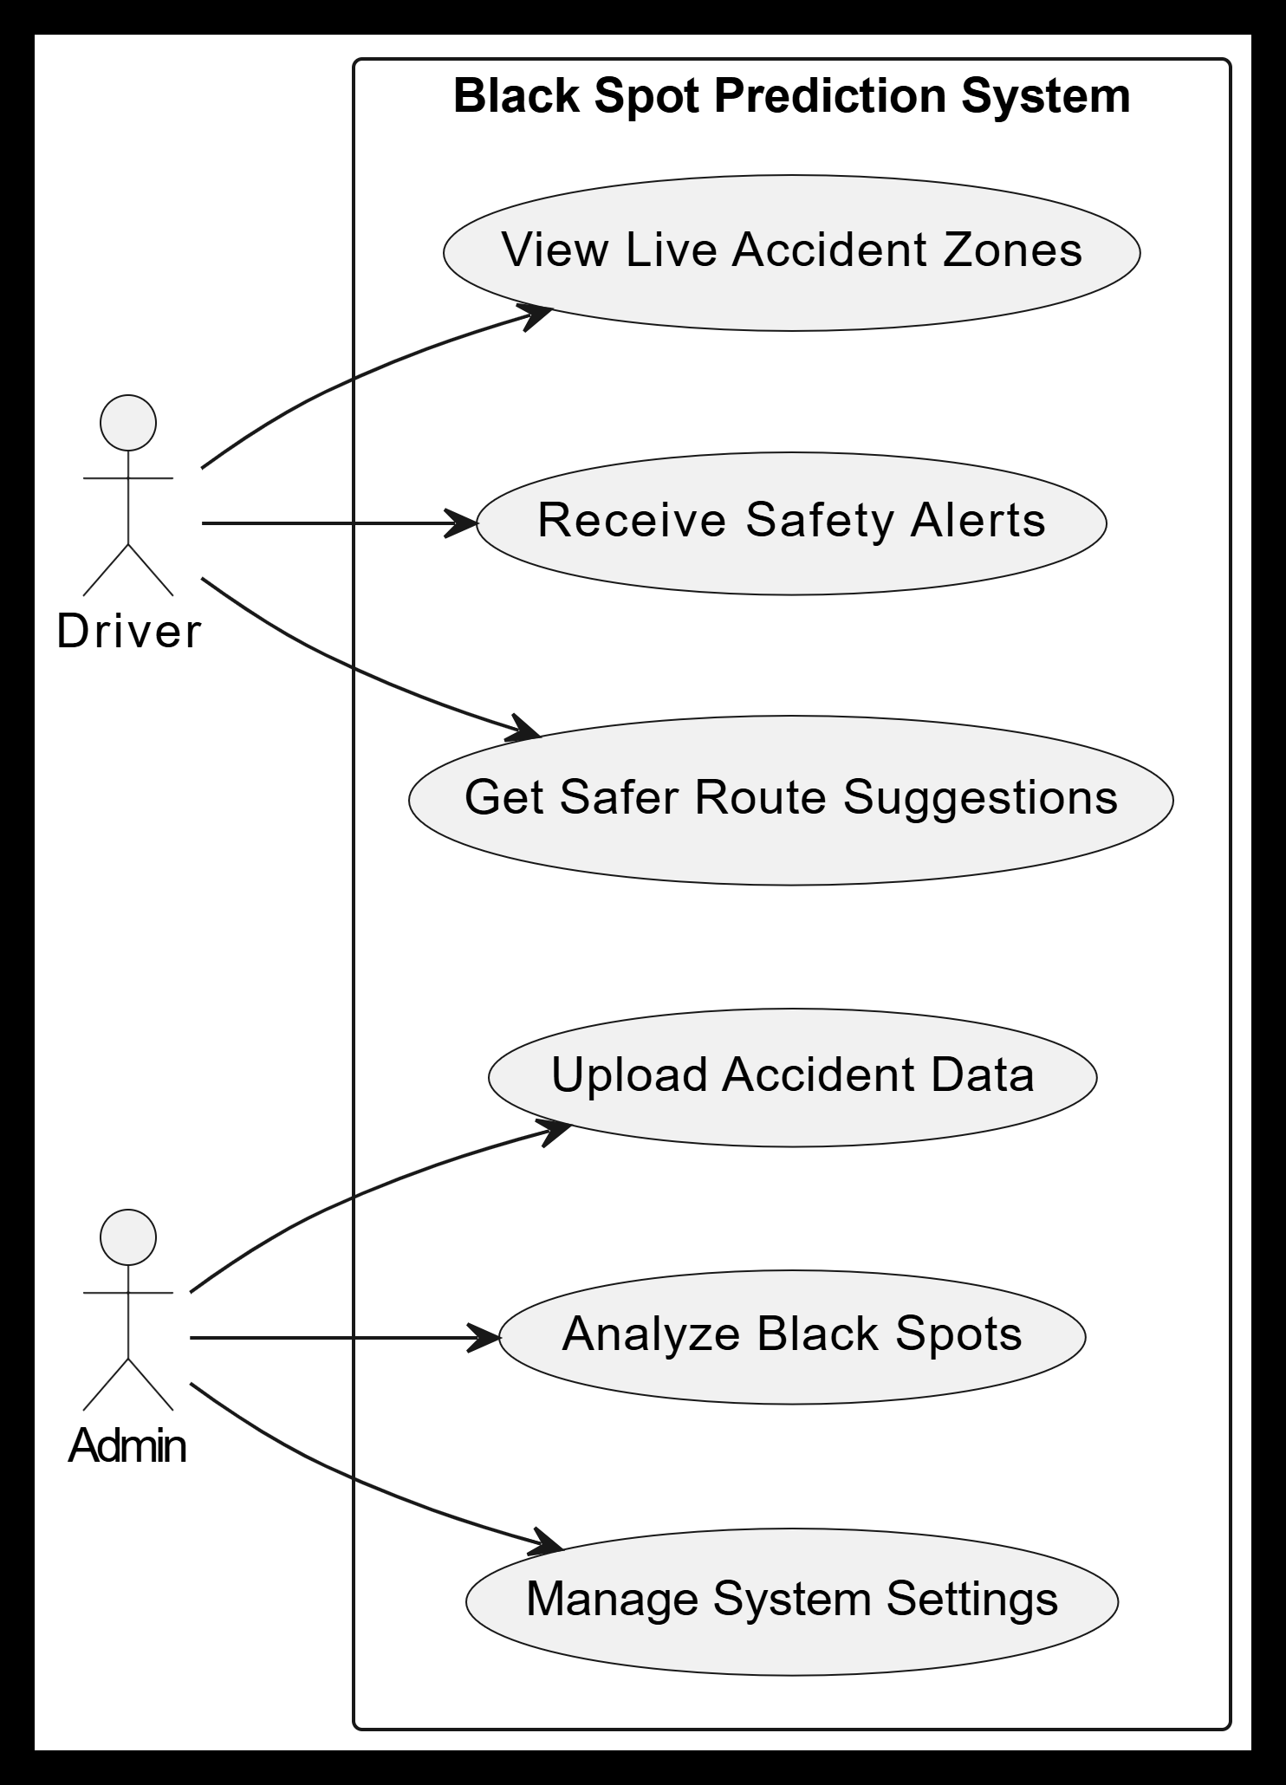
USE CASE DIAGRAM
The Use Case Diagram of the Black Spot Prediction System represents the interactions between different users (actors) and the system itself. It helps identify the main functionalities the system should provide and how users will engage with them. In this project, the primary actors include the Driver and the Admin. The Driver interacts with the system to receive real-time alerts about accident-prone (black spot) areas, based on GPS tracking.

Slide 12
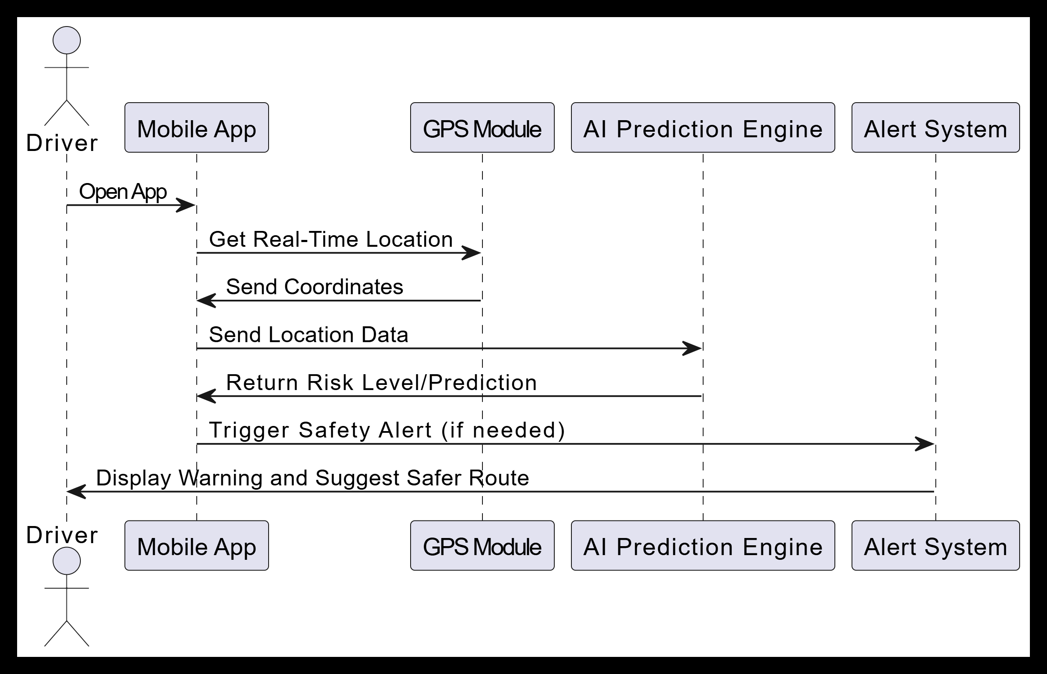
USER SEQUENCE DIAGRAM

Slide 13
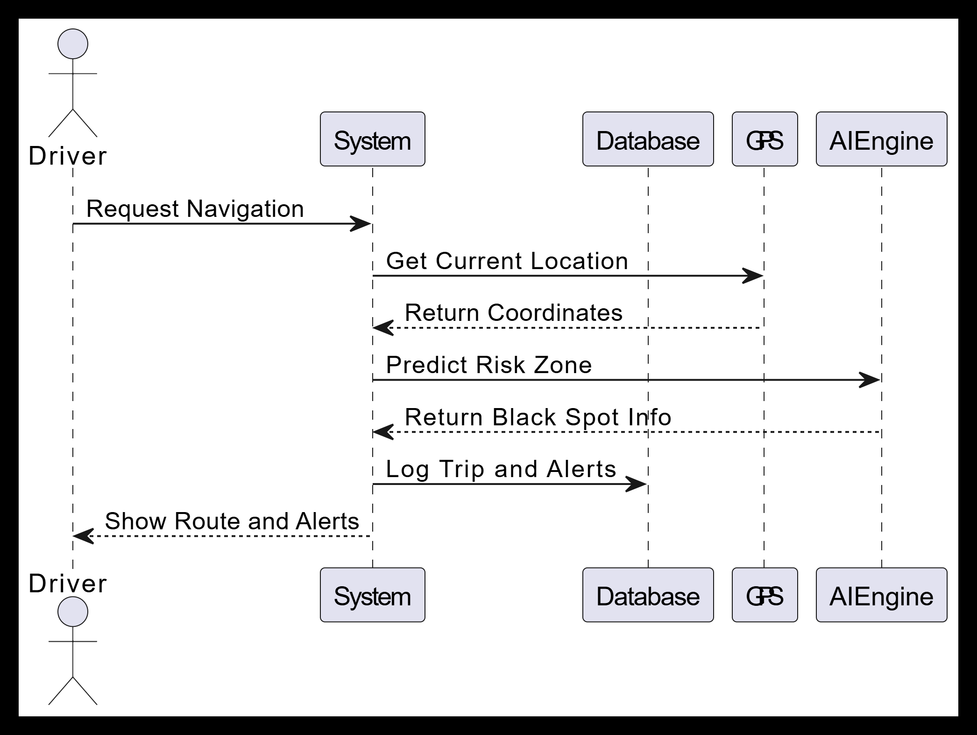
SYSTEM SEQUENCE DIAGRAM

Slide 14
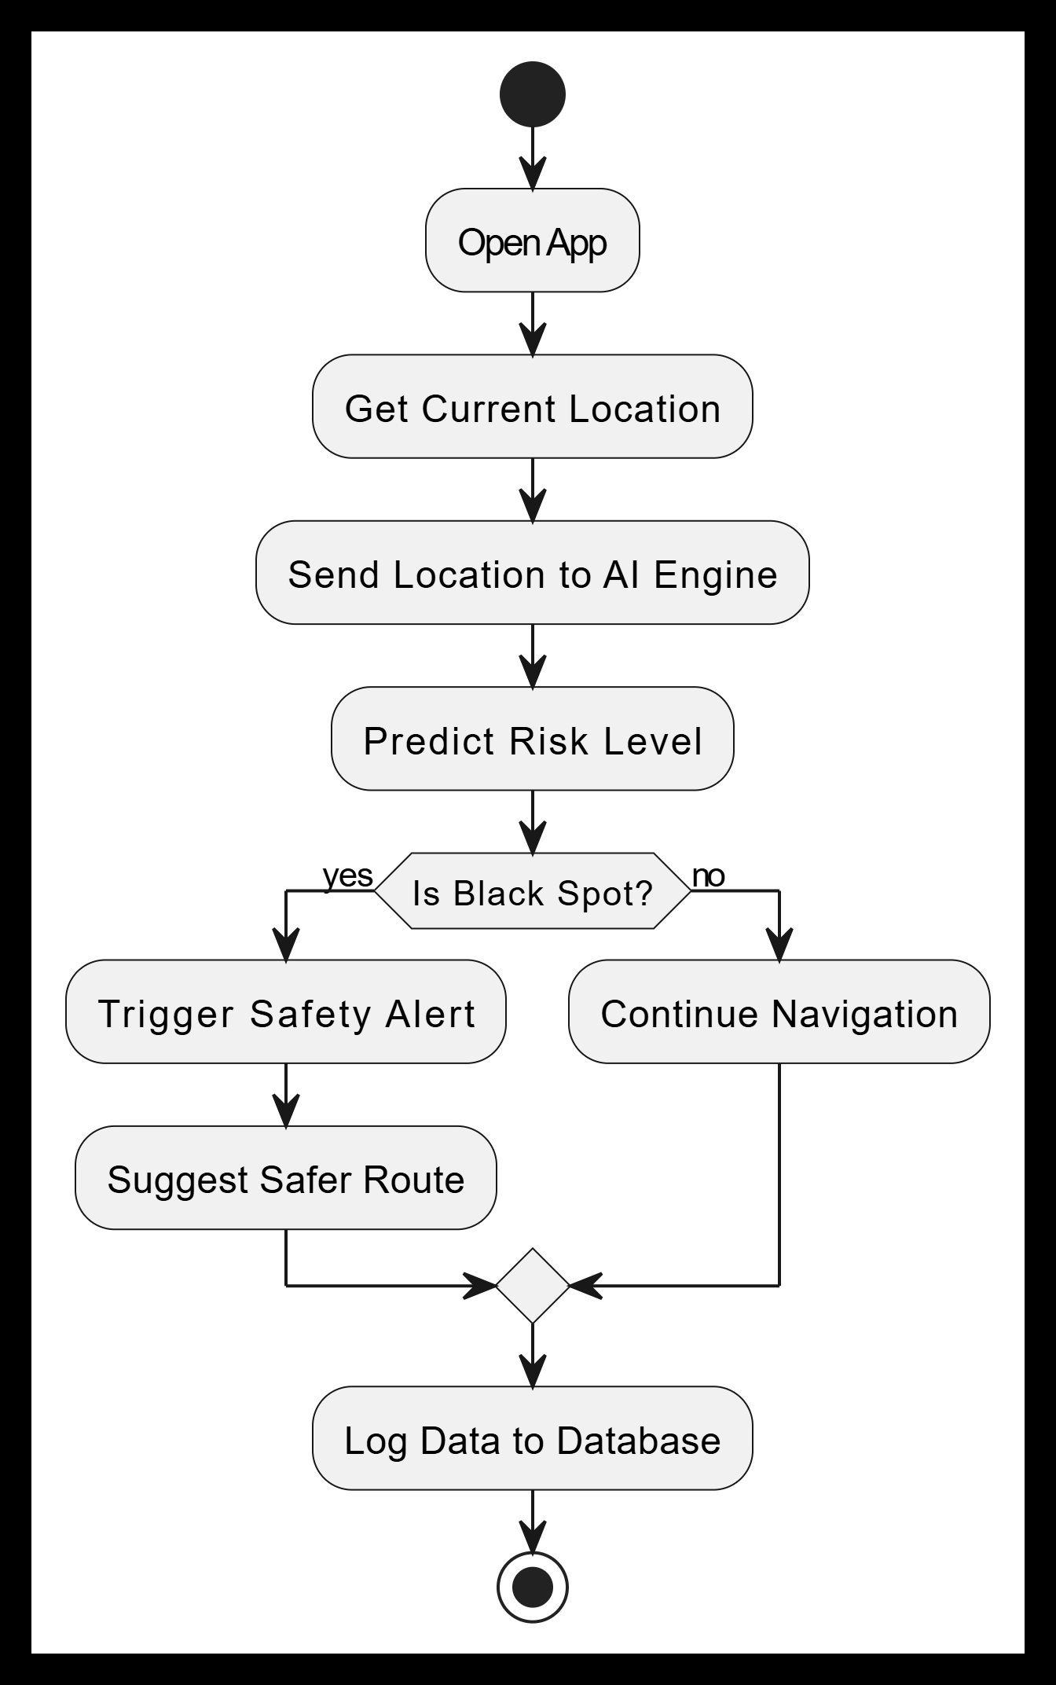
ACTIVITY DIAGRAM
The Activity Diagram of the Black Spot Prediction System represents the workflow and sequence of activities that occur during the system’s operation. It shows how the system behaves in response to user actions and internal processes, using a flowchart-style format. For example, when a Driver logs in, the system fetches their real-time GPS location, checks if they are approaching a black spot, and then generates a safety alert

Slide 15
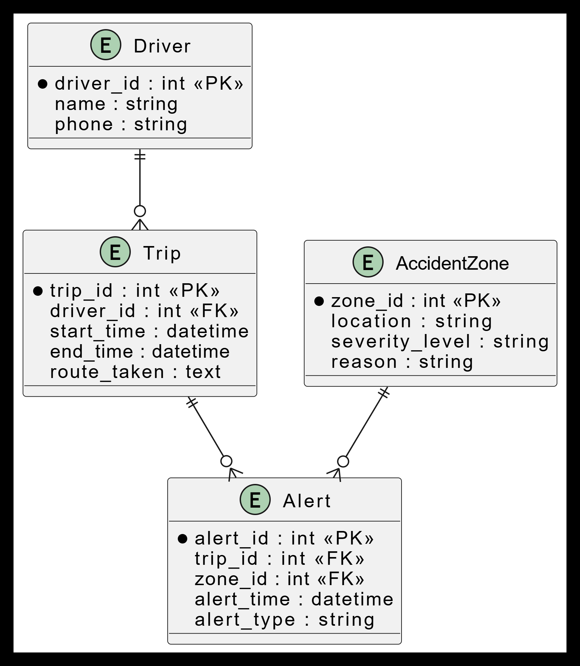
DATABASE DESIGN
The Database Design of the Black Spot Prediction System defines how data is organized, stored, and related within the system. It includes a set of structured tables that hold important information such as user details, location data, accident records, black spot zones, and alerts.

Slide 16
CODE QUALITY
Code quality plays a crucial role in ensuring that the black spot detection system is reliable, maintainable, and scalable. The implementation was written using Python with libraries such as NumPy, Pandas, Scikit-learn, and Tkinter for the GUI.
Modular Structure
The project was divided into separate modules:
Data preprocessing module
Model training module
Prediction module
Graphical User Interface (GUI)
This modular approach makes the code easy to understand, debug, and upgrade.
2. Readability and Documentation
Meaningful variable names such as latitude, longitude, is_blackspot were used.
Comments were added to explain each important step.
Functions were created for repeated tasks such as:
  Loading dataset
  Training model
  Making predictions

Slide 17
3. Error Handling
Basic exception handling was added to avoid crashes:
Handling missing dataset files
Handling invalid user input
Handling model loading errors
4. Reproducibility
Dataset splitting used a fixed random state.
The trained model was saved using joblib so that predictions remain consistent.
5. Performance Considerations
Random Forest was chosen because it provides high accuracy and works well with geographical data.
The dataset size is small, so training time is fast.

Slide 18
Output Demonstration
The developed system provides a simple graphical interface for users to check whether a location is a black spot.
Step-by-Step Output Flow
User opens the application.
User enters:
  Latitude
  Longitude
User clicks Predict button.
The system loads the trained model.
The model predicts whether the location is a black spot.
Result is displayed instantly.

Slide 19
Example Output
Input:
Latitude: 17.3850
Longitude: 78.4867
Output:
Result: Black Spot Area
Input:
Latitude: 16.5062
Longitude: 80.6480
Output:
Result: Safe Area
GUI Output Features
User-friendly interface
Instant prediction
Clear result messages
Error messages for invalid input

Slide 20
Testing
Testing ensures that the system performs correctly under different conditions.
1. Unit Testing
Individual modules were tested separately:
Dataset loading
Model training
Prediction function
GUI input validation
2. Functional Testing
The full system was tested by entering different coordinates and checking predictions.
Test cases included:
Test Case | Input Type | Expected Result
Valid Coordinates | Known black spot | Predict black spot
Valid Coordinates | Safe area | Predict safe
Invalid Input | Letters instead of numbers | Show error
Empty Input | No value enterd | Show warning

Slide 21
3. Model Testing
The dataset was split into:
80% Training data
20% Testing data
Accuracy was measured using the test dataset.
4. Usability Testing
The application was tested by different users to ensure:
Easy to use interface
Clear instructions
Fast response time

Slide 22
Results
The machine learning model produced promising results for identifying accident-prone locations.
1. Model Accuracy
Using the Random Forest Classifier:
Training Accuracy: ~95%
Testing Accuracy: ~90–93%
This shows that the model generalizes well to unseen data.
2. Confusion Matrix Summary
The model correctly classified most locations:
True Positives: Correctly identified black spots
True Negatives: Correctly identified safe areas
Very few misclassifications
3. Advantages of the System
Fast prediction time
Simple and user-friendly interface
Can assist traffic authorities
Helps in accident prevention planning

Slide 23
4. Limitations
Accuracy depends on dataset quality
Only uses latitude and longitude (limited features)
Needs real accident data for real-world deployment
5. Future Improvements
Add traffic density and road condition data
Use deep learning models
Integrate with Google Maps API
Deploy as a web/mobile application

Slide 24
Conclusion
The Black Spot Detection System using Machine Learning successfully demonstrates how data-driven techniques can help identify accident-prone locations. By using geographical coordinates and a Random Forest model, the system provides quick and reliable predictions through a simple user interface.
The project shows that machine learning can support road safety planning by helping authorities focus on high-risk areas and take preventive measures. Although the current model uses limited features, it provides good accuracy and serves as a strong foundation for future improvements such as adding real accident data, traffic density, and road conditions.
Overall, the system proves that machine learning can play an important role in reducing road accidents and improving public safety.

Slide 25
Questions Discussion

Slide 26
THANK YOU

